Slide 1
Followership
(insert date)

Slide 2
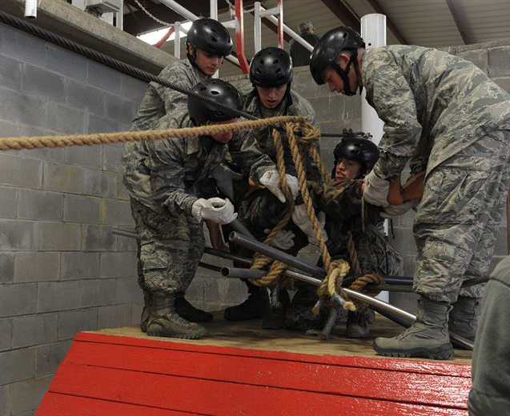
The Exemplary Follower
The exemplary follower is
motivated,
has intellect,
is self-reliant,
and is dedicated to achieving the mission of the organization.
Robert E. Kelly
The Power of Followership
Flight commanders are the first line leaders and followers in the Department of the Air Force. This is a key tenet of the Squadron Officer School professional military education, shown here with Project X, in use since the 1950s.
USAF Photo by Staff Sgt Gregory Brook

Slide 3
Objectives
By the end of this lesson, you will be able to:
Identify characteristics of effective followership.
Interpret guidelines for followership in practice.
Develop strategies and actions that foster effective followership.

Slide 4
Small Group Discussion
In your small groups, consider the following question:
What characteristics do good followers in the Department of the Air Force demonstrate?
Record your own personal answers on the worksheet provided.
(You don’t need a group answer – everyone can make a personal list.)
Five (5) minutes – then be prepared to discuss your results

Slide 5
What Did You Learn?
What characteristics do good followers in the Department of the Air Force demonstrate?
Why are these characteristics important?

Slide 6
Followership in Practice
How do you put followership into practice?

Slide 7
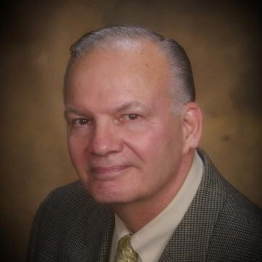
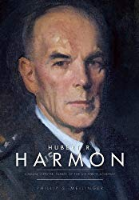
Rules of Good Followership
Colonel Philip S. Meilinger, USAF (Ret.)
Ten Rules of Good Followership
What would you add?
What would you change?

Slide 8
Followership Action Plan
In your small groups, consider the following questions:
Record your own personal answers on the worksheet provided.
(You don’t need a group answer – everyone can make a personal list.)
Ten (10) minutes – then be prepared to discuss your results
What should you do to improve followership in yourself?
What should you do to build followership in your flight?

Slide 9
Followership Action Plan
How can you foster followership in your flights?

Slide 10
Self-Assessment Exercise
Evaluate yourself
Use your own Checklist for Effective Followership
How well do you stack up against your own criteria?
Remember
Your results are private – sharing is not the intended goal
Contemplate steps for future improvement
You will need these worksheets to finish your Personal Development Plan (PDP) and complete this course.

Slide 11
Break
Come back in 10 minutes!

